Slide 1
Completing your FAFSA
Zachary Baltazar

Slide 2
Before you start- What you will need:
In order to complete your FAFSA easily and efficiently you will need:
  Social Security Number/ Drivers License
  If you are not a U.S. Citizen, Alien Registration Number
  Student’s Federal Income Tax Returns; W-2; other records of money earned.
  Parent’s Income Tax Return, W-2; other records of money earned.
  Bank Statements/Investments
  Records of untaxed income
  University School Code
    TAMUCC School Code: 011161

Slide 3
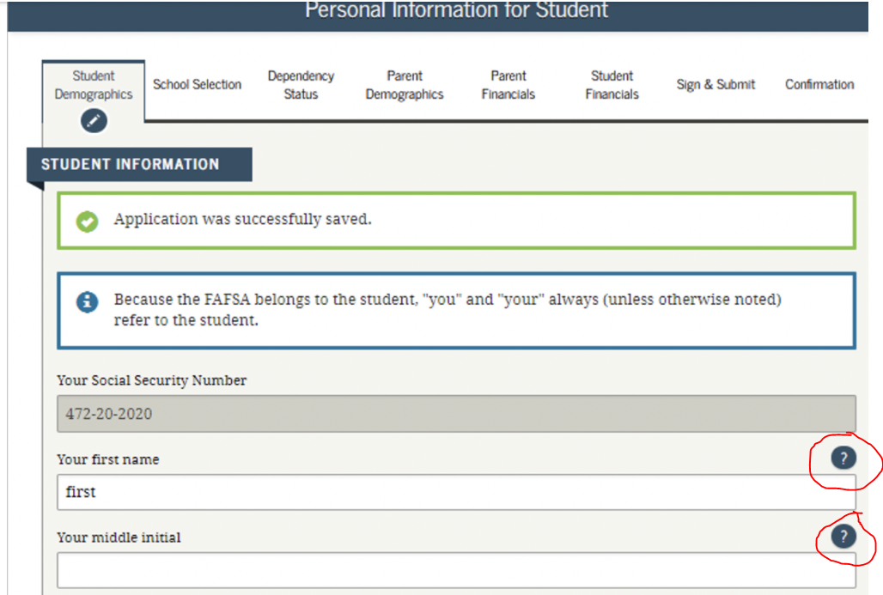
Notes:
On every step there will “?” to the right of the question that will help you figure out what they are looking for.

Slide 4
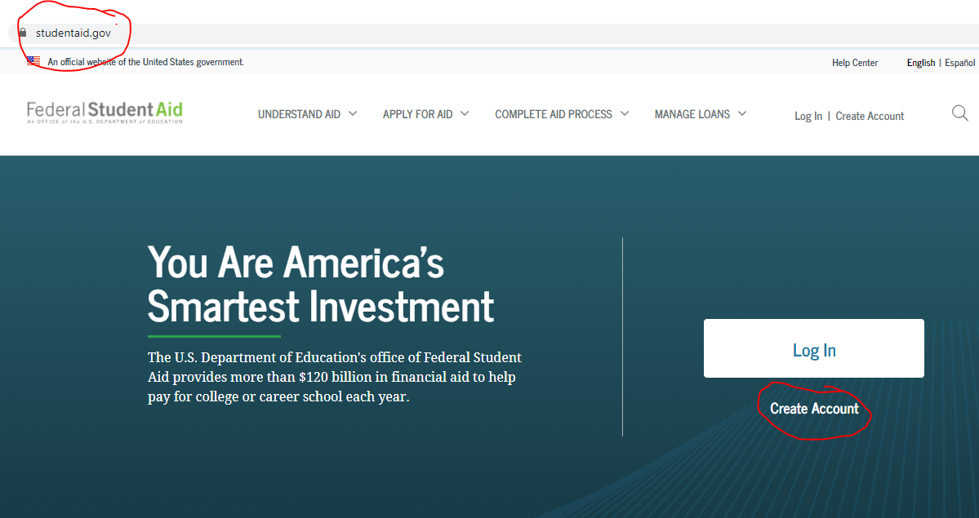

Slide 5
Step 1: Login and Get Started (Students)
You will need to create an FSA ID and Login for the student.
  Please make sure to use your personal email just incase you lose or forget your password.
For Parents will need the students:
  First Name
  Last Name
  Student’s SSN
  Student’s Date of Birth
Start the 2021-2022 FAFSA
Create a save key

Slide 6
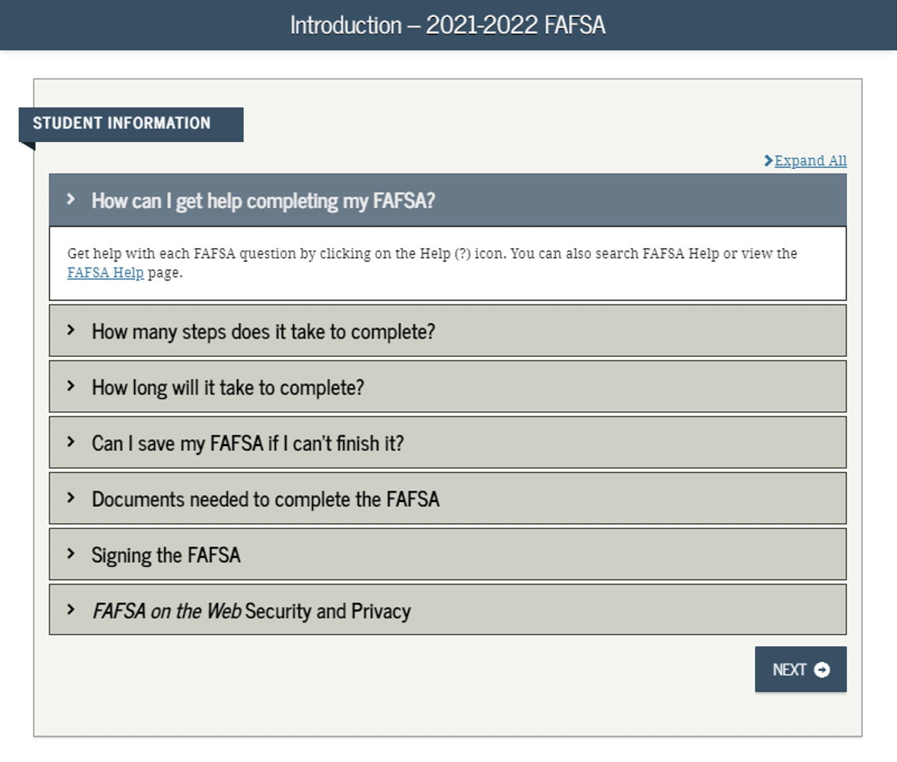

Slide 7
Step 2: Student Demographics
This is where you will need to input personal information:
1st Part: SSN, First Name, Middle Initial, Last Name, Date of Birth
  Please Double Check
2nd Part: Student E-mail and Phone
3rd Part: Student Address- Mailing Address, City, State, Zip
4th Part: Student Residency and Eligibility
5th Part: Student Education
6th Part: Selective Service Status (Males) www.sss.gov
7th Part: Driver’s License
Last: Student Foster Care and Parent Education Completion

Slide 8
Step 3: School Selection
Search for your High School:
  Name of High School
  City of High School
  State of High School
Double Check and select the Correct High School
Now you will search for the College/Colleges
  If you do not know the School Code; you can search for it during this part.
  Please select any and every University that you are interested in. (10 max)
  TAMUCC School Code: 011161
Housing Plan: TAMUCC requires students to live on campus for their first year.

Slide 9
Step 4: Dependency Status
For this section you will need the following information:
Marital Status
Dependents: Do you have anyone who is dependent on you?
  Kids, ppl in your household (ONLY if you are providing more than 50% of their living expenses.
Additional Dependency Questions
  Please carefully go over these and select the ones that apply to you.
Student Homelessness
Dependent Student
  Can you provide information about your parents?

Slide 10
Step 5: Parent Demographics
You will need your parents information: Additionally they should be able to login and access your application to input their information.
This will follow the same process as the Student Demographic except it will be for the parent.
Additionally, they will ask for:
  Household Size- People living in the household
  Number of people in the household attending college
    Count yourself, but also include any siblings who will attend and be enrolled as part-time students, as well. You do not want to include your parents in this section, even if they are in college or a degree-seeking program.
NOTE: You will use the information of the Parent who you live primarily live with and their partner/step-parent

Slide 11
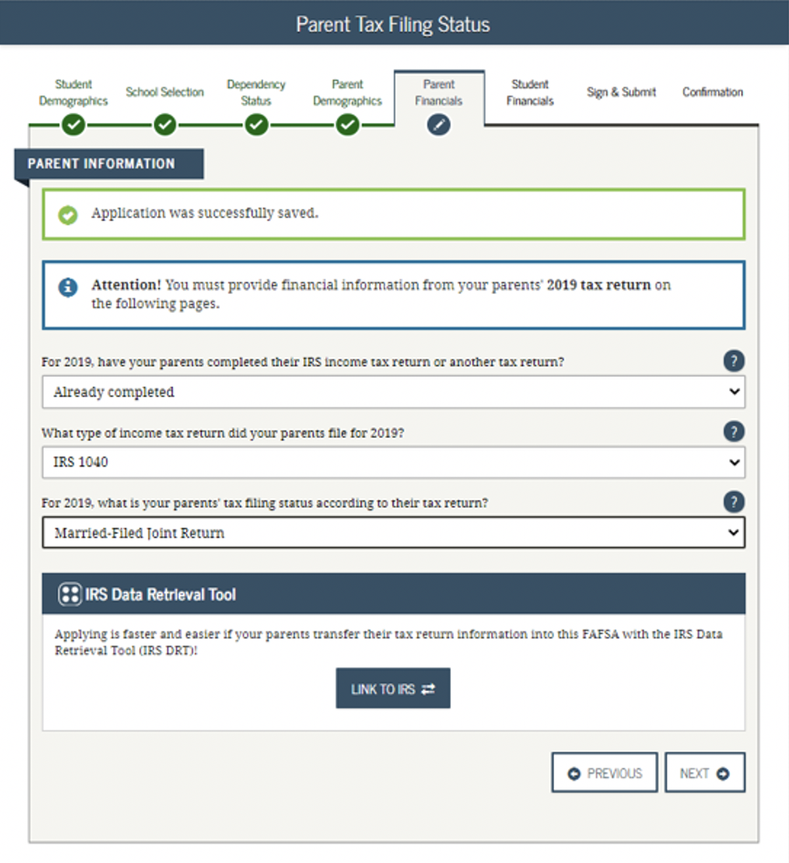

Slide 12
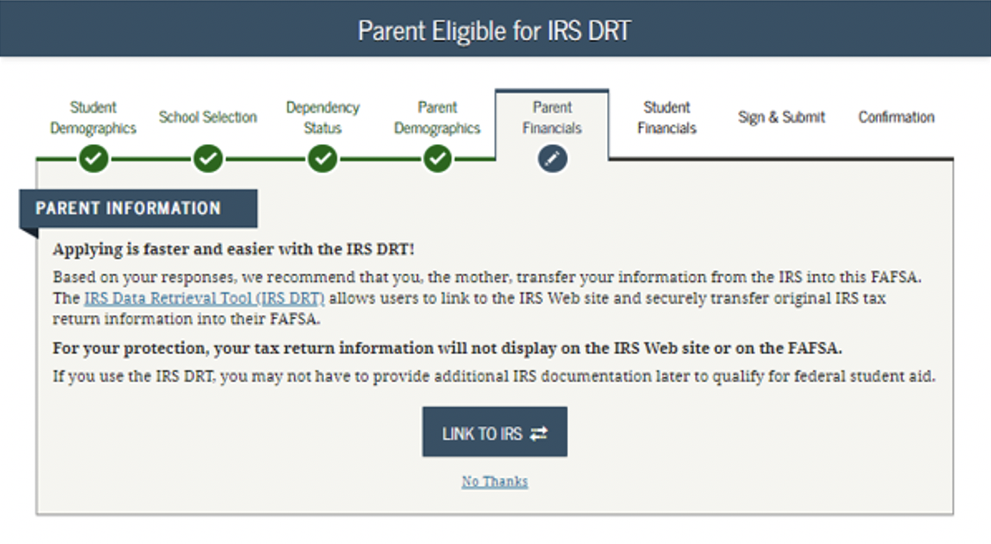
Step 6: Parent Financials
This is where the “?” or help button will come in handy. This part can be hard to navigate.
Some people will be able to transfer their Parent’s Tax Information with the IRS Data Retrieval Tool. (recommended)
There will be some “Smart Questions” so what is asked may be different from person to person.

Slide 13
Step 6: Parent Financials (Cont.)
If you are not able to use the Data Retrieval Tool: Parents will need to submit their Financial Information manually.
Parents Adjusted Gross Income for 2019
  can be found on either Line 37 (1040), Line 21 (1040A), Line 4 (1040EZ) of their Federal tax return.
    Parents who are married but file separate returns will need to combine their AGIs from their individual return for this field

Slide 14
Step 6: Parent Financials (Cont.)
Smart Questions:
  Parent Income from Work
  Parent Simplified Path Determination
  Parent Additional IRS Info
  Parent Questions for Tax Filers Only
  Parent Additional Financial Info
  Parent Untaxed Income
  Parent Assets

Slide 15
Step 7: Student Financials
Process will be similar the Parent Financial Steps. Which we will go over again.
Please note: that if you did not file taxes in 2019; the university will require you write a statement verifying you did not work in 2019.

Slide 16

FINAL STEP- SIGN AND SUBMIT
There will be a summary overview; Please take some time to review it and make sure the information is correct.
Both the student and the parent will need to sign to verify that all the information is correct.
Either parent can sign.
Once completed there will be a confirmation
  Page that you should print out.

Slide 17
Valuable Resources
Completing the FAFSA 2020-2021 Video
  https://youtu.be/Y8nfk5ApcQ4
Step by Step FAFSA guide by Nitro College:
  How to Complete the 2021-2022 FAFSA Application

Slide 18

Congratulations!
Your FAFSA has been officially submitted.

Slide 19
Contact Information
Financial Aid Office
Office: 361-825-2338
Fax: 361-825-6095
Email: faoweb@tamucc.edu
osfa.tamucc.edu
Contact me directly at:
Zachary.baltazar@tamucc.edu
or
Schedule an Appointment

