Slide 1


Mentor Teacher Training
Adopted from Ginger Tucker’s Mentor Training
Ensuring Success for New Teachers

Slide 2

Welcome
Purpose: to provide lead teachers and mentors with the knowledge and skills to provide support so that the new teachers and their students have the opportunity to be successful
You will…
  Gain a basic understanding of what mentoring is and is not
  Investigate some issues impacting new teachers
  Acquire strategies for providing assistance
  Grow as a professional
Notes:
Use Mentor Questionnaire to lead discussion for the role of mentors and their abilities to impact new teachers. The idea behind this activity is to give mentor teachers the need for gaining mentoring skills and knowledge without offending them. Most mentors believe they are good teachers and they will be good mentors, but this activity reveals that is 2 different skill sets.

Slide 3
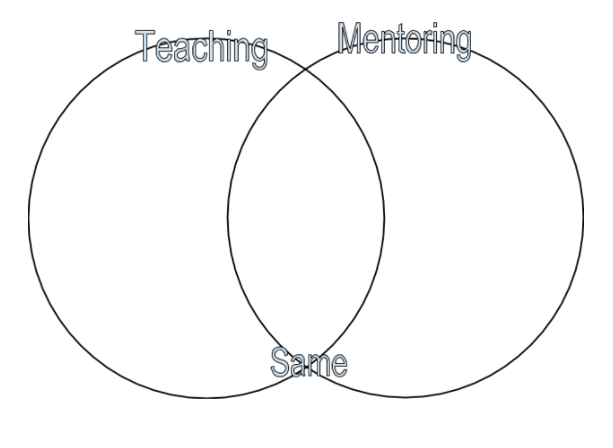
Notes:
Use this slide to debrief the questionnaire activity

Slide 4
Overview
What is our goal?
First year teacher induction
New teacher orientation
Mentor support throughout year
On-going new teacher trainings throughout year
Notes:
Facilitate a discussion about the goals of an effective new teacher induction program…then share the basic plan for the year and take feedback, suggestions.

Slide 5
Characteristics of an Effective New Teacher
Possess a deep understanding of the subjects they teach.
Evidence a firm understanding of how students learn.
Create a positive learning environment.
Use a variety of assessment strategies to diagnose and respond to individual learning needs.
Demonstrate and integrate modern technology into the school curriculum to support student learning.
Collaborate with colleagues, parents and community members, and other educators to improve student learning.
Reflect on their practice to improve future teaching and student achievement.
Pursue professional growth in both content and pedagogy.
Instill a passion for learning in their students.
Notes:
NCTAF produced this list of characteristics of highly qualified new teachers in 2003. This list can be a framework for our vision for outcomes of a new teacher during the first year of their career leading to many more successful years.
This list is our goal!

Slide 6
Characteristics of an Effective School
Clear and focused mission
High expectations for success
Instructional leadership
Frequent monitoring of student progress
Opportunity to learn and time on task
Safe and orderly environment
Home-school relations
Notes:
Highlight page ___ in mentoring handbook.

Slide 7
School Factors the Influence Achievement
A guaranteed and viable curriculum
Challenging goals and effective feedback
Parent & community involvement
Safe & orderly environment
Collegiality & professionalism
Notes:
Trobert Marzano (most significant educational researcher of today) shares these factors as what makes the biggest impact on school achievement

Slide 8
Teacher Factors the Influence Achievement
Effective classroom strategies
Effective classroom management
Effective classroom curriculum design
Notes:
Robert Marzano (most significant educational researcher of today) shares these factors as what makes the biggest impact on school achievement

Slide 9
Student Factors the Influence Achievement
Home environment
Learning intelligence/background knowledge
Motivation
Notes:
Robert Marzano (most significant educational researcher of today) shares these factors as what makes the biggest impact on school achievement

Slide 10
Characteristics of an Effective Mentor
Has a passion for the profession.
Is a learner.
Is a trusted listener.
Is supportive and challenging.
Is a champion of FYTs
Is accepting of differences.
Is positive.
Is an effective classroom manager.
Is an effective instructor.
Is effective at working with adults.
Is effective in working with parents and families.
Notes:
From Sandra J Odell: How does this impact the success of an mentor?
Demonstrated excellence in teaching (model good practices in instruction, discipline, management, etc)
Demonstrated excellence in working with adults (team player, good communication skills, positive role model)
Sensitivity to viewpoint of others (knows it does not have to be “my way”…plenty of personality and style differences)
Active and open learner (model life-long learning by initiating learning opportunities for the new teacher and himself)
Competent social and public relations skills (integrity to profession and professional in dealing with administrators, parents, colleagues)

Slide 11
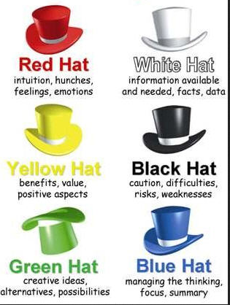
The Mentor
Reflect on the qualities and characteristics for mentors using Six Hats Thinking
Notes:
Divide by table and ask each table group to select/assign a color to analyze their thoughts on the characteristics of effective mentors.

Slide 12
Barriers To Remember
The mental roller coaster of the 1st year
Generational differences
The double barrier to assistance
  Beginning teacher is hesitant to request assistance
  Experience teacher is reluctant to interfere and/or give advice!

Slide 13
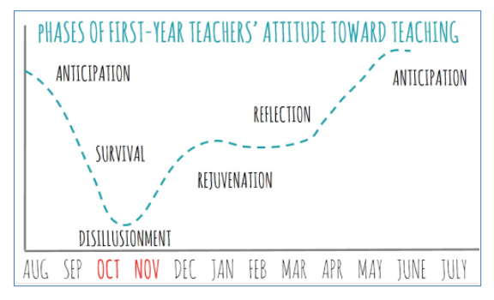
Needs of a New Teacher
Notes:
Reference pages --- in manual to discuss the mental status and brainstorm ways for mentors to support new teachers through each phase

Slide 14
Generational Differences
Who are the new teachers?
  Young & right out of college
  Second career or alt certified
  Returning teacher
  Out of state teachers
Veterans-Baby Boomers-Gen X-Millennials
  Life events
  Preferences
Notes:
All first year teachers are not the same age, from the same backgrounds, and they do not all have the same needs. We need to understand who they are in order to help.
Young out of college- has the “book” knowledge of an education degree with limited classroom experience
2nd career- often experts in their subject areas, but may not have ideas on classroom management or realistic expectations
Returning & out of state teachers- may have lots of experience, but are behind the times or not familiar with Texas standards.
Reference page---- of manual for the charts on generational difference and facilitate a discussion on the differences and preferences

Slide 15
Mentoring Strategies
Facilitative: true coach, facilitates conversations that are inquiry-based with open ended questions, reflection, insights, non-judgment support for planning, reflecting, and problem-solving.
Collaborative: mentor and new teacher share ideas and problem solve, mentor and new teacher plan, co-teach, share resources, do action research, and learn together.
Instructive: Mentor provides information, technical assistance, informs, communicates, and directs new teachers in areas where the NT needs information.
Notes:
Discussion leading into strategies (from handbook):
What do NT Need?
Training, mentoring, and/or coaching in needed areas
Time to implement with coaching and feedback
Support and follow-up
Without assistance, NT will resort to:
Coping with ineffective strategies
Copying negative behaviors of others
Quitting (or worse, staying)
3 ways to mentor
Facilitate discussion on when to use each styles and how each look

Slide 16
Mentor Tips
Introduce and orient the new teacher to the school
View a new teacher’s classroom to provide objective non-judgmental data
Arrange reciprocal classroom visits
Model a demonstration lesson

Slide 17
Mentor Tips
Help the new teacher…
  Identify and access school and community resources
  Develop classroom rules and routines
  Set up classroom
  Plan lessons
  Analyze student work
  Use formal and informal assessment strategies
  Unpack the standards and collaboratively unit plan
  Prepare for supervisor’s observations
  Communicate effectively with parents
  Prepare for parent-teacher conferences
  Understand and comply with clerical responsibilities

Slide 18
Other Needs??
Think to your first year….
How could/did a strong mentor help you?
What did you still need to know?
Notes:
Facilitate discussion

Slide 19
Mentoring Levels
Buddy: The mentor is responsive to immediate needs and questions. This is the day-to-day unstructured “just-in-time” help, including quick questions and “got-a-minute” issues.
Colleague: The mentor and new teacher have regularly scheduled time for planning and collaboration.
Induction Coach: The mentor facilitates a highly structured relationship with the new teacher driven by a vision and goals that are aligned with the induction program using tools and protocols to achieve the desired results.
Notes:
When to use and why would all 3 be used by the same mentor/NT relationship?
Examples and how they see their own role (space to write in the manual)

Slide 20
Types of Conference Structures
Clinical supervision
  Pre-conference with teacher
  Classroom observation
  Analyzing and interpreting the observation and determining the conference approach
  Post-conference with teacher
  Reflection and follow-up
Notes:
Similar to T-TESS model or TAP Coaching model

Slide 21
Types of Conference Structures
Peer Coaching
  Administrator facilitates pre and post conference
  Peers observe classes and provide feedback
  Peers support new teachers with information, feedback, guidance, and quality advice
Notes:
Mentor model in the traditional sense

Slide 22
Types of Conference Structures
Critical Friends Group
  Small groups of teachers with a common interest
  Meet regularly with a facilitator to look at student work, examine curriculum and instructional strategies, and/or analyze student data
  Protocols are used by the group to focus efforts
Notes:
Maybe great for pods, teams, departments

Slide 23
Types of Conference Structures
Professional Learning Communities
  Small groups of teachers with common interest
  Accomplishes three goals:
    Creative formative assessments and analyze student data
    Plan instruction to meet students needs
    Learn together
  Have a common vision and mission
  Sets goals to guide their work
  High performing teams have high expectations for all
Notes:
Assist new teachers to be full contributors to PLCs

Slide 24
Guiding Questions
What are the new teacher’s needs and desires?
What is the purpose of the conference?
What is the level of skill and attitude of the new teacher?
What are the goals of the conference?
What format or protocol will best facilitate our purpose?
Notes:
Help plan your visits with NT by asking these questions

Slide 25
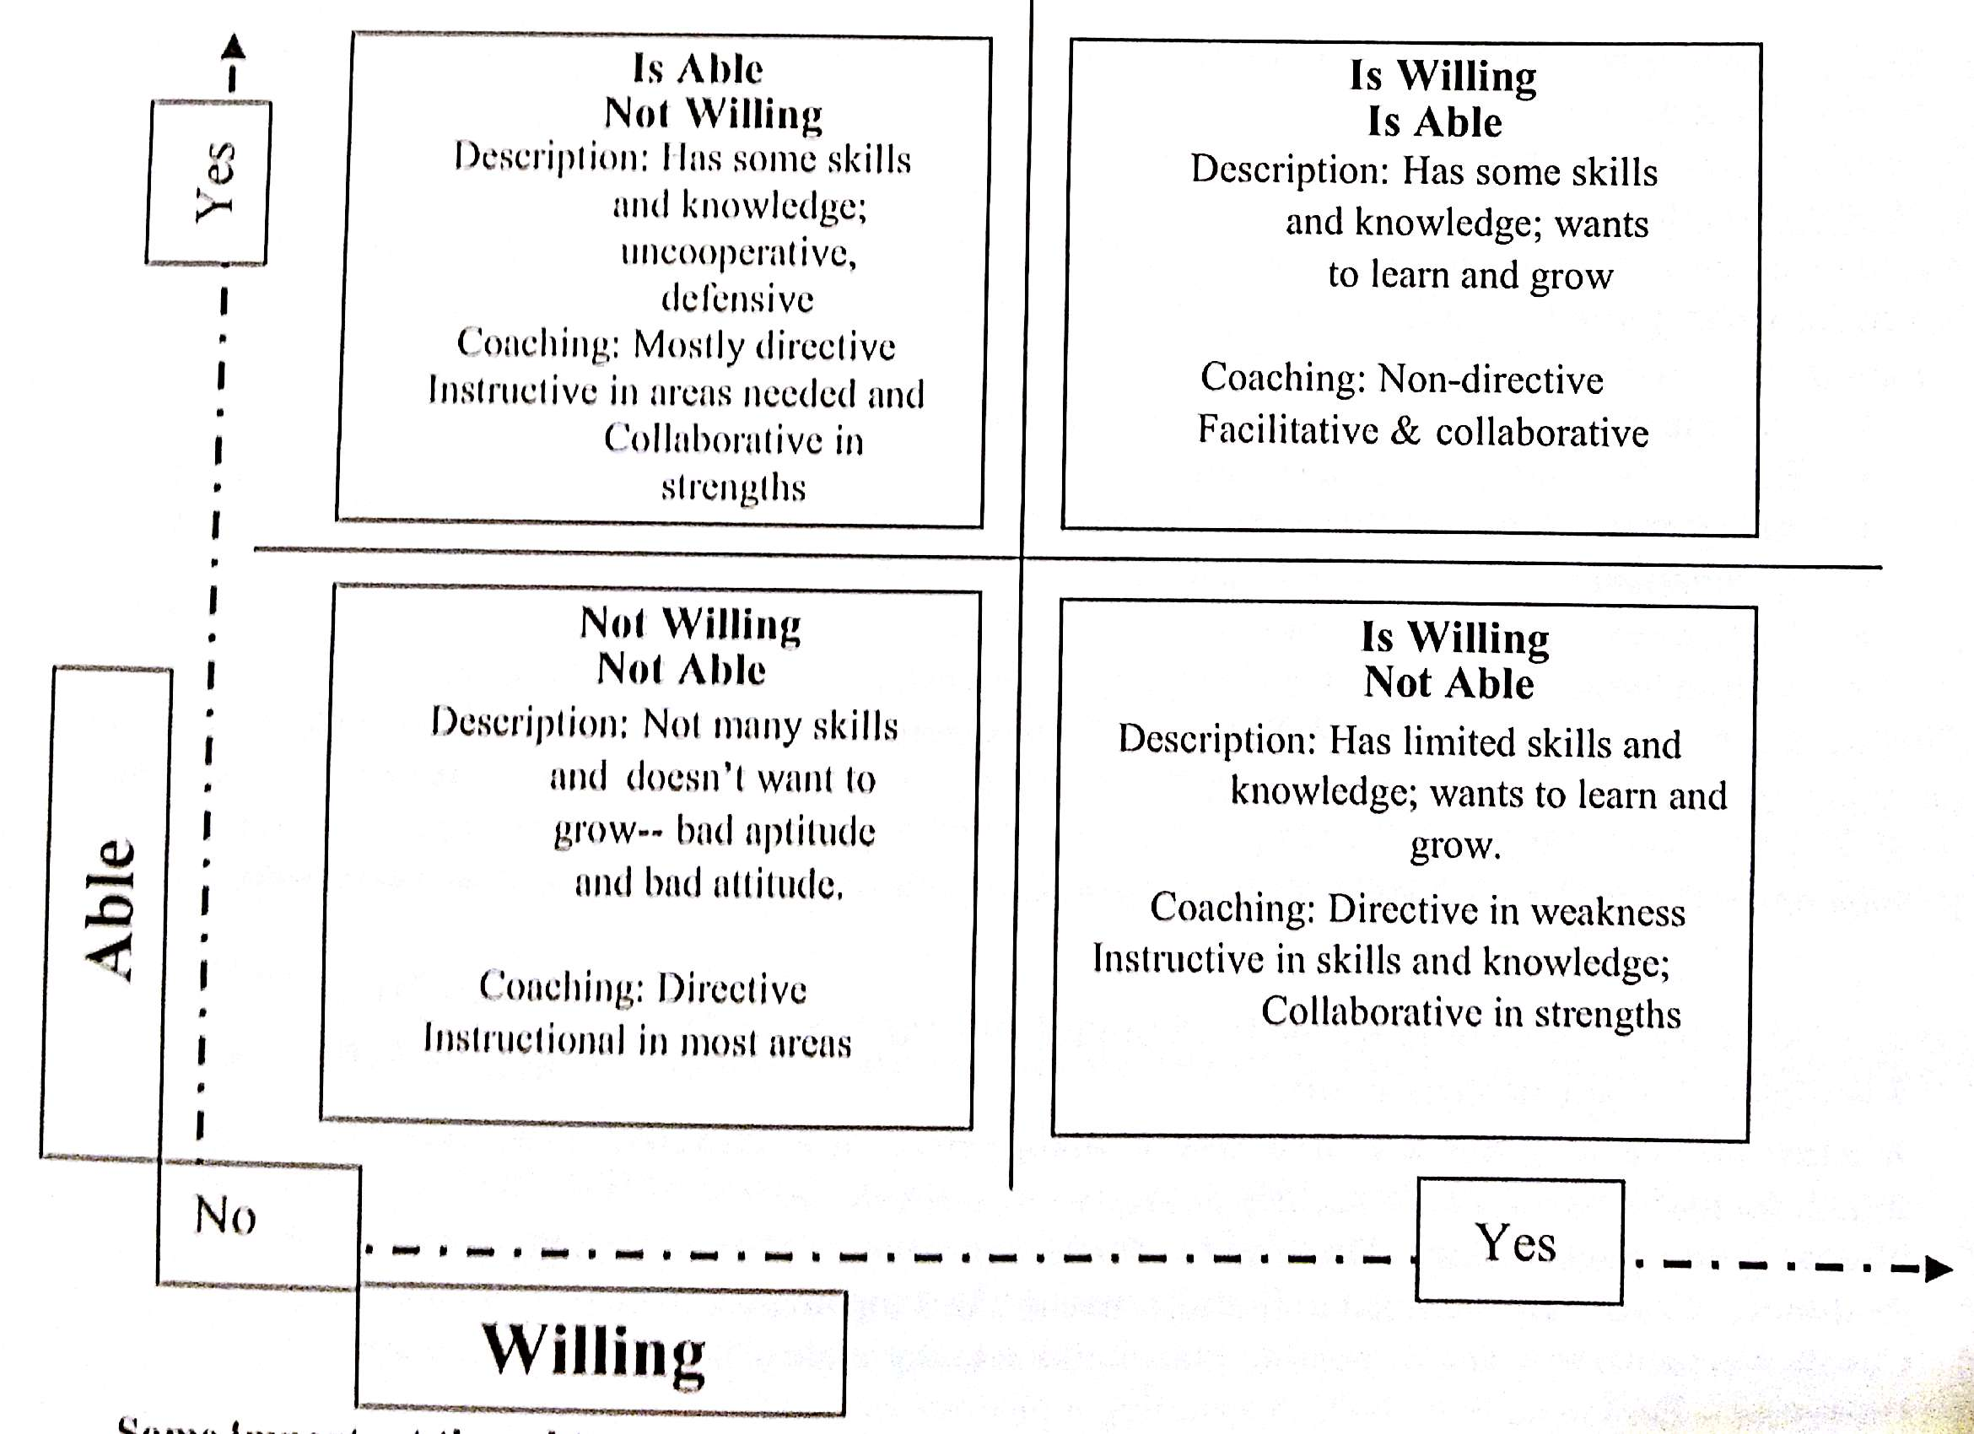
Notes:
How would NT in each quadrant benefit from different styles or tools of coaching?
Not willing/not able
not many skills and doesn’t want to grow
Poor attitude, poor aptitude
Coaching style: directive and instructional in most areas
Not willing/is able
Has some skills and knowledge, but uncooperative, defensive
Mostly directive some collaborative
Is willing/not able
low skill, very coachable attitude
Has limited knowledge and skills, but wants to learn and grow
directive in weakness, instructive in skills and knowledge, collaborative in strengths
Is willing/is able
High skill, very coachable attitude
Has some skill and knowledge, wants to grow and learn
Non-directive style, facilitative and collaborative

Slide 26
Avoid Barriers
Disagreeing
Criticizing/Blaming
Global Praising
Advising
Diagnosing
Excessive Questioning
Moralizing
Logical Arguing
Ordering/Threatening
Reassuring
Diverting
Monoluing
Notes:
Discuss how important it is when someone comes to us with an issue for us to listen without being defensive.
Regardless of level of teacher, remember these areas to avoid to the greatest extent possible

Slide 27
Handy Tools
Planning for a Successful Year
Mentor Observation of New Teacher Record
New Teacher Observation of Mentor Record
Categories of Support Checklist for Mentors
Monthly Checklist for Mentors
Resources for P-20 and P-TECH conversations
Notes:
Reference forms in manual and how to use
Walk through each form and the appropriate use

Slide 28
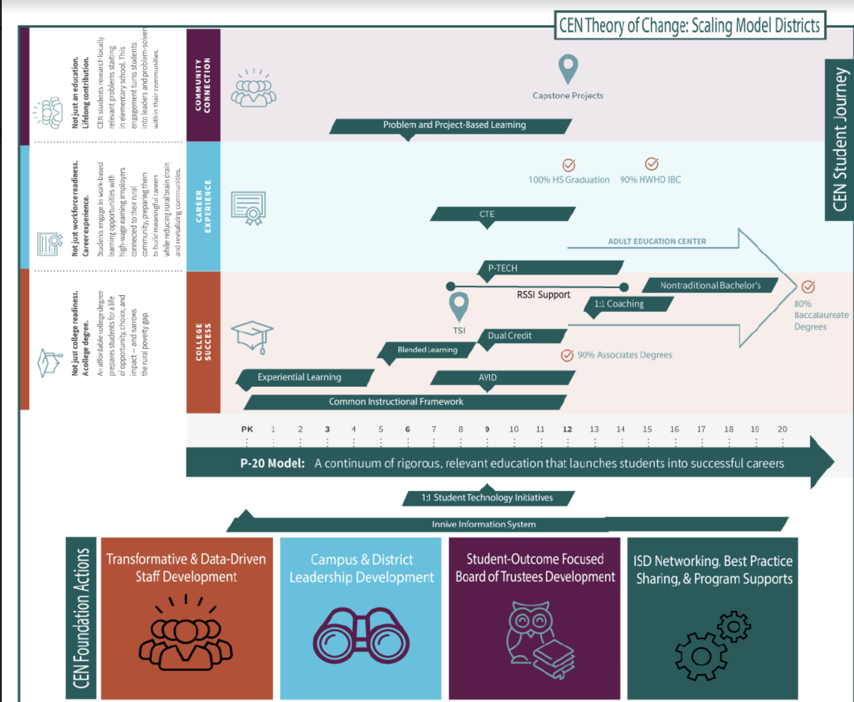

Slide 29

CEN P-20 Playbook

Slide 30
P-TECH Blueprint
Benchmark 1: School Design
The P-TECH program must offer open enrollment and flexible scheduling structures that enable students to combine high school, postsecondary courses and work-based learning, at no cost to participating students.

Slide 31
P-TECH Blueprint
Benchmark 2: Target Population
The P-TECH program shall serve, or include plans to scale up to serve, students in Grades 9 through 14, and shall target and enroll students who are at risk of dropping out of school as defined by the Public Education Information Management System (PEIMS) and who might not otherwise go to college.

Slide 32
P-TECH Blueprint
Benchmark 3: Strategic Alliances
Strategic partnerships with business and industry partners and IHEs are formally articulated in writing and clearly define a variety of careers.

Slide 33
P-TECH Blueprint
Benchmark 4: Curriculum, Instruction, and Assessment
The P-TECH program shall provide a rigorous course of study that enables a participating student to receive a high school diploma, an associate degree, postsecondary certificate provided by an IHE, or industry certification during Grades 9- 14.

Slide 34
P-TECH Blueprint
Benchmark 5: Work-Based Learning
The P-TECH program must offer students a variety of relevant, high-skill work-based learning experiences at every grade level that respond to student interest and regional employer needs and contribute to students earning aligned industry certifications and credentials.

Slide 35
P-TECH Blueprint
Benchmark 6: Student Support
P-TECH will provide wrap-around strategies and services involving multiple stakeholders (parents, teachers, counselors, community members, etc.) to strengthen both the academic and technical skills necessary for high school and college readiness, as well as provide academic, technical, and individual support for students to be successful in rigorous academic and work-based learning experiences.

Slide 36
Banquete Collegiate POS
Programs of Study:
1) Health Science • Healthcare Diagnostics (Principles of Health Science, Medical Terminology, Health Science Theory, Anatomy and Physiology and/or Practicum) • Healthcare Therapeutic Services (Principles of Health Science, Medical Terminology, Anatomy and Physiology or Health Science Theory, Practicum) • Medical Therapy (Principles of Health Science, Medical Terminology, Anatomy and Physiology or Health Science Theory, Practicum)
2) Manufacturing • Welding (Intro to Welding, Welding I, Welding II, Practicum or Career Prep)

